Slide 1
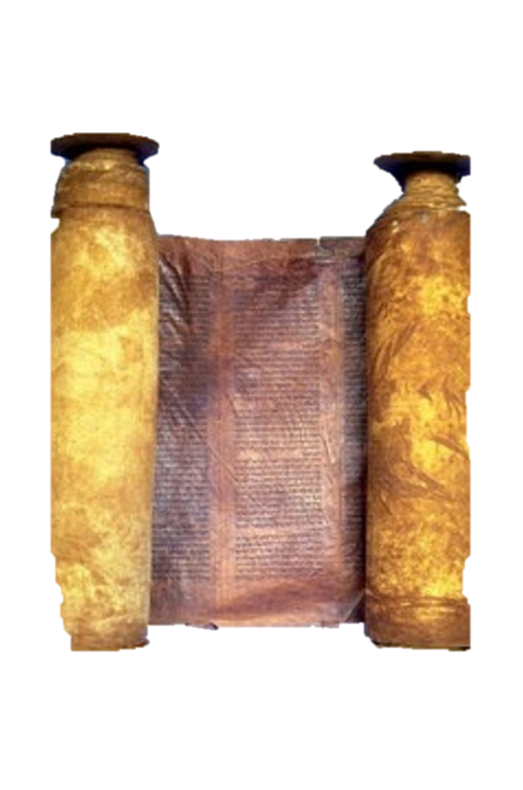
A free CD of this message will be available immediately following the service
1 Kings
21-22
A podcast will also be available later this week at calvaryokc.com

Slide 2
Adam Clarke ~ “The penitent heart ever meets the merciful eye of God; repentance is highly esteemed by the Father of compassion, even where it is comparatively shallow and short-lived.”
1 kings 21-22

Slide 3
1 kings 21-22

Slide 4
Judah
Israel
Ahab and Jezebel
Jehoshaphat
Jehoram
Athaliah
1 kings 21-22

Slide 5
1 kings 21-22

Slide 6
Verse 6: Lord ~ Adonai
Verse 7: LORD ~ YHWH
1 kings 21-22

Slide 7
1 kings 21-22

Slide 8
Micaiah ~ Who is like Yahweh?
1 kings 21-22

Slide 9
1 kings 21-22

Slide 10
1 Kings 21:19 ~ “You shall speak to him, saying, ‘Thus says the Lord: “Have you murdered and also taken possession?” ‘And you shall speak to him, saying, ‘Thus says the Lord: “In the place where dogs licked the blood of Naboth, dogs shall lick your blood, even yours.”’”
1 kings 21-22

Slide 11
1 kings 21-22

Slide 12
Israel
Judah
Jeroboam, 931-910
Rehoboam, 931-913
Nadab, 910-909
Abijam, 913-911
Baasha, 909-886
Asa, 911-870
Elah, 886-885
Zimri, 885
Omri, 885-874
Ahab, 874-853
Jehoshapat, 871-847
Ahaziah, 853-852
c
1 kings 21-22

Slide 13
1 kings 21-22

